Slide 1

Getting Students Engaged in Learning
Easier Said Than Done

Slide 2
Engaging Students in Learning
An age-old problem, even before the pandemic
Let’s reflect on our own experiences
What motivates you to attend a meeting, training, conference, etc.

Slide 3
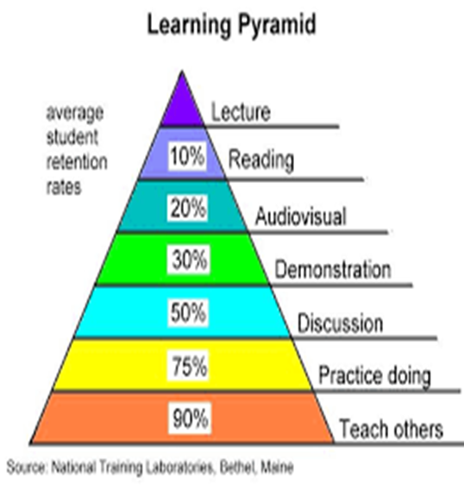

Are We Upside Down?

Slide 4

What is Student Engagement?
Emotional
Cognitive
Behavioral
More than just keeping students awake during history.
Notes:
In an article by Maria Kampen (online April 2020), Student engagement is when they show up to class excited to learn, participate in learning, and demonstrate a positive attitude.
Here are 3 types of student engagement Behavioral – don’t act out, have supplies, follow instructions, participate in class….basically the PERFECT student, right? Emotional – feel like they are a part of the school community and are happy to be there! Cognitive – intellectual engagement. Eager to learn, ask challenging questions, and go above & beyond when completing assignments. Wouldn’t that be wonderful.

Slide 5
Definition of Student Engagement
“A long-term disposition towards learning – viewing learning as fun, seeing it as important, seeing the value of working with and functioning as part of a team, being part of a social institution. To me, those are critically important lifelong skills.”
Engaged students = lifelong learning students
Notes:
This definition is according to Douglas Willms, director of the Canadian Research Institute for Social Policy at the University of New Brunswick & a member of the US National Academy of Education.

Slide 6
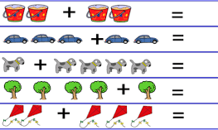
What it Boils Down to……
Increased student engagement and learning go hand-in-hand
Capturing students’ attention + Actively involving them in the learning process = increased student achievement.

Slide 7
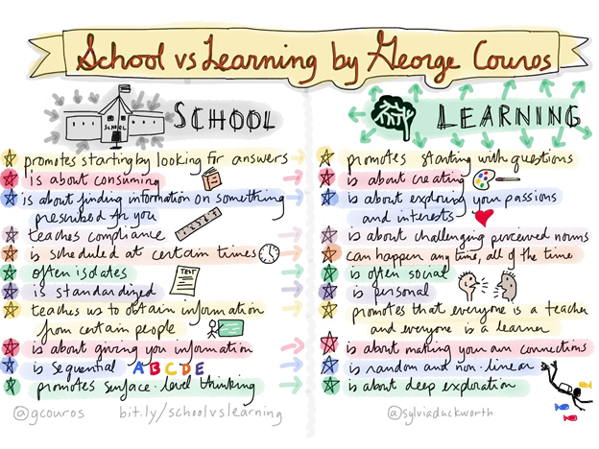
Notes:
This comes from an online blog by George Couros. This image is by Sylvia Duckworth created in a comment to the post. George Couros is the author of “the Innovator’s Mindset” & “Innovate Inside the Box”
In his blog, Mr. Couros wrote that as he though about the traditional model of school, he felt that the school can actually get in the way of learning. Schools that are doing amazing jobs are promoting their students as learners and not just learning stuff.
Think back on information that really stuck with you. Why did that happen? Was it because you were already interested, or the teacher/speaker made it interesting?
When I was in college, I had to take Louisiana history. I had no real drive to learn Louisiana history, but I had to have the course. The professor wrote the book that was, of course, our text. I remember enjoying that class more than most history courses because he made it come to life. He told us little tidbits of information that made you want to hear more.

Slide 8

How Can We Increase Student Engagement?
Make it Meaningful
Strengthen Students’ Sense of Competence
Give Them Some Control
Embrace Collaborative Learning
Build Relationships
Golden Rules for Engaging Students in Learning Activities by Nicolas Pino-James. https://www.edutopia.org/blog/golden-rules-for-engaging-students-nicolas-pino-james

Slide 9
Make it Meaningful
Connect the learning to previous knowledge & experiences
Highlight the value in personally relevant ways
Bring in “experts” from the community – someone recognizable by the students
Make sure your lessons consider the cultural make-up of your class
Geometry – pool, golf, football, hockey
Math - link word problems to student interests or use their names in the problems
Civics, Writing – use a current news story and have the students write a solution, or be prepared to explain why it effects the community.
Reading – Have reading passages that are relevant or focused on an area of real interest
Notes:
How many of us care about sitting and listening to someone talk about a topic that has nothing to do with our specific job, our interests, or our family’s well-being? We will say, or think, what millions of students have said everyday. “Why do I have to learn this? I’m never going to use this!”
So, if we want a student to be engaged and motivated to learn, we have to answer their question, “Why do I have to learn this?” or maybe a better question is “Why do I need to learn this?”
You are going to have to get to know your students. You can blend the required with the desired.

Slide 10

Get Them Writing
Journals
  Private – trust shared only with teacher
  Spelling doesn’t count
  Set parameters
  May be only a few words

Slide 11

Use Student Interests
Written by Paula Kluth & Patrick Schwarz
Autism Spectrum Disorders
Purpose
  Expand Social Opportunities
  Expand Communication
  Minimize Anxiety
  Boost Literacy
  Inspire Career Ideas
Notes:
This is one of the basic recommendations when teachers ask me how to get students engaged.
Even though this book was written to help teachers, parents, and service providers understand the power of a student’s focused interest in limited topics, I think the same philosophy can be used with all students. When interviewed, individuals with ASD wanted these authors to express their feeling that educators should not considered these interests as obsessions to be extinguished, but fascinations, passions, or enthusiasms than can be used as tools to engage the students.

Slide 12
Strengthen Student’s Sense of Competence
Errorless learning
  Wait time
  Priming – an intervention that prepares students for an upcoming difficult activity
Play to their strengths
Only positive feedback
Reciprocal teaching
  Predicting – using title, cover art, headings, table of contents
  Questioning – Who, what, where, when, why, how
  Clarifying – reread & breakdown difficult parts
  Summarizing – most important points
Notes:
None of us like to do something we don’t feel confident doing….especially in front of others. Why would we expect a student to be engaged and interested if they feel like they are just going to fail? Students who continue to fall short of the teacher’s expectations will often just give up and “check out.”
Priming – examples: let student have the question(s) ahead of time so they can be prepared for the answer. Give them the answers so that they can participate in the discussion. Give them the reading passage ahead of time so they can work on fluency.
Playing to their strengths will keep any student from feeling like the class failure. If they like to be the center of attention, let them teach a concept. You might have to limit a student to a specific amount of time, but they may be more successful than if they are just expected to read a passage or answer math problems. Obviously, we would never force a student to teach if they do not want to…it should not be perceived as a punishment.
With Reciprocal Teaching you increase reading comprehension by getting the students more involved in the process. You would use the I Do, We Do, You Do formula. You can build interest by asking questions that are relevant to the students. Take into consideration the audience.

Slide 13
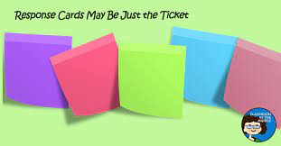


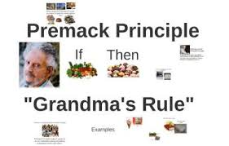
Give Them Some Control
Personalized Learning
  Goal-setting
  Multiple response methods
  Blended Learning - Flipped classroom
Work-Break Routines
  Break work into smaller doses
  A form of the Premack Principle
  Can be adjusted as on-task time is getting less resistance
Notes:
As humans we all seek some power and control in our lives. We tend to become anxious or upset when we perceive that we have no control over a situation. Think about our students, particularly the young children. Usually, they are told what to wear, what to eat, when to eat, when to play, when to go to bed, etc. They have very adult-driven lives. And that is usually a good thing. But, we wonder why those same students get into the classroom and they are reluctant, disruptive, or disengaged. Maybe they are controlling the few events they feel are in their power. For years I have recommended that teachers give students some control during their day. They need to feel that they are part of the educational process, not just that it is happening to them.
Personalized Learning – involve students in goal-setting for themselves; let them choose creative ways to show their knowledge. Flipped classroom – may be an idea that is used intermittently. The students watch the lesson at home, or read the passages at home with video guidance. Then the class time is used in discussion, problem-solving, and meeting individual needs. The down side of this strategy is if the student does not have access to internet/technology at home or if the parents cannot assist due to a language barrier.
Work-Break – tell about David’s students using their phones during class. It is kind of a version of the Premack Principle

Slide 14
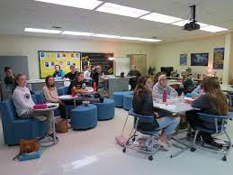
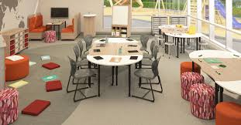
Give Them Some Control
Given Them Choices
  Flexible seating
  Build in movement
    Centers/stations
    Gallery Walk
  Writing – choose the instrument. Pen, pencil, crayon, marker,
  Student highlights or circles the number of problems to answer or paragraphs to read
Notes:
As humans we all seek some power and control in our lives. We tend to become anxious or upset when we perceive that we have no control over a situation. Think about our students, particularly the young children. Usually, they are told what to wear, what to eat, when to eat, when to play, when to go to bed, etc. They have very adult-driven lives. And that is usually a good thing. But, we wonder why those same students get into the classroom and they are reluctant, disruptive, or disengaged. Maybe they are controlling the few events they feel are in their power. For years I have recommended that teachers give students some control during their day. They need to feel that they are part of the educational process, not just that it is happening to them.
Personalized Learning – involve students in goal-setting for themselves; let them choose creative ways to show their knowledge. Flipped classroom – may be an idea that is used intermittently. The students watch the lesson at home, or read the passages at home with video guidance. Then the class time is used in discussion, problem-solving, and meeting individual needs. The down side of this strategy is if the student does not have access to internet/technology at home or if the parents cannot assist due to a language barrier.
Work-Break – tell about David’s students using their phones during class. It is kind of a version of the Premack Principle
Give them choices. Sure, you have veto power, and you will have to set parameters but make them think it is their idea.
Flexible seating. It is not just choosing where to sit, but maybe on what do I sit. I saw a teacher get into a power struggle with a student because the student wanted to sit on the floor to do his math. Privately, I asked the teacher if there was a reason he had to sit in a chair (IEP goal, PT, OT). She said well that everyone else sat in chairs. We agreed that math is a subject that can be done on the floor. In the past few years vendors are recognizing that seating does not just have to be a desk and a straight-back chair. It can be a stool, a beanbag, a cushion, a balance ball. Some of these actually help the student concentrate more on the task and not how sore his/her backside is getting sitting in a hard chair.

Slide 15

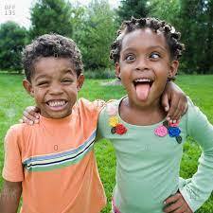
Brain Breaks
Limited by your own creativity
Do a one-minute drawing about the lesson
Keep an inflatable beachball from touching the floor
5, 4, 3, 2, 1 – 5 actions
  5 jumping jacks
  4 push-ups
  3 situps
  2 squats
  1 tree pose
Make silly faces for 30 seconds
Focus on a sound like a chime or gong. Eyes closed and breathing slowly and deeply
Take a yoga break
Do the wave
Jump up and down for one minute
Mindfulness cards - https://fit.sanfordhealth.org/resources/mindful-moments-printable?utm_source=blog&utm_medium=website&utm_campaign=weareteachers
Notes:
Brain Breaks – Get the students up and moving. Do something completely different like a one-minute drawing about the lesson, toss around a beach ball Take a yoga break. For older students it may be as easy as giving them a 3-minute break to talk to someone within 6 ft. of their desk. They could pair up and tell each other their favorite song, movie, ice cream, sport.

Slide 16

Embrace Collaborative Learning
Delivering instruction through small groups
Formal or spontaneous
Teacher models how the collaboration works
Perfect for project-based learning
  The Oscar goes to…
  An ancient society
  Design a playground, vehicle, space station
  Research a food chain.
Notes:
Have students script a part of a significant historical event to exercise their drama, history, and creative writing skills.
Using elements from other ancient societies create a unique one. It must satisfy Maslow’s hierarchy of needs. They would have to explain how all their elements fit into Maslow’s pyramid.
Choose a food chain and research its prices and apply algebra concepts to find the base cost of the pizza. Then they can determine the profit margin.

Slide 17

Build Relationships
Get to know your students
You do need classroom rules
  State them positively – Say what you want, not what you don’t want
  Let the students have some ownership by making suggestions
Build routines that are consistent
Emphasize that all comments should be neutral or positive.
Build in one-on-one time for each student as often as possible
Keep your word
Diversify your learning materials
Listen to them talk
Notes:
Building routines helps you focus on the instruction and not just where to put everything. The routine is consistent, the activities should be varied.
Establish standards for classroom interactions.
One-on-one time – it might be only 5 minutes and until you gain the trust of some students you may be doing all the talking but keep the appointment.
Don’t make promises you may not be able to keep. If you promise 10 minutes of visiting at the end of the class period if they stay focused during the lesson, you must follow through or they will not believe you again.

Slide 18
Gamification
Reward & recognition – it’s not bribery
01
Point system
02
Use of technology during class
03
Change up your terminology to match what your students are doing in their free time
04
Game over = Time’s up
Stages = Topics or lessons
Levels = Steps in a project
Experience Points = Scores
Notes:
Does not have to be competitive, but can be a way to earn preferred activities, get out of homework free, Mystery Motivator,
A point system is an easy way to earn rewards. Rewards do not have to be tangible. They can be access to preferred activities, preferred people, time to do nothing, music, etc. Points can be earned for stuff as simple as attendance, in class on time, homework turned in before end of the week. Think about what is causing the most disruption in the class and figure out what is reasonable to expect, then assign it points. Just as an aside…..if you are giving multi-step instructions during the class, please have them written somewhere so that those students who have trouble with language processing or maintaining attention will have a support system in place so that they do not feel a need to shut down, or not complete the task.
If the students insist on keeping their phones out in class, use that and redirect the use for good – look up facts, use Google or IMDB, use Siri….

Slide 19
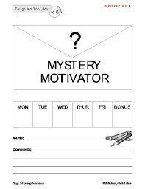
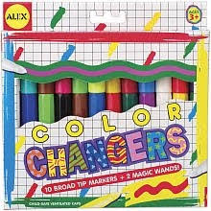
Mystery Motivator
Dr. William Jensen
Teacher Toolkit
Mystery Motivator

Slide 20
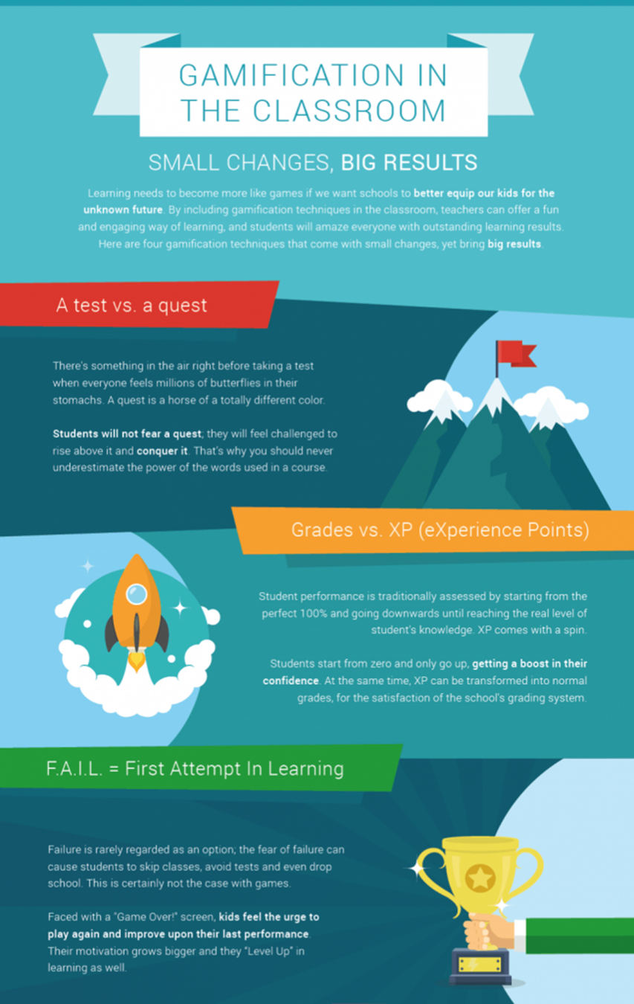

Slide 21
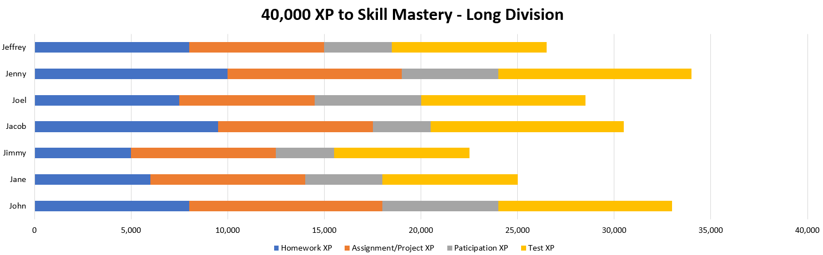
Make Progress Visible

Slide 22
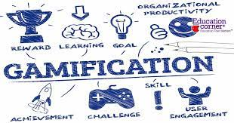
Benefits of Gamification
Engagement
Tangible Progress – The idea of filling a progress chart can be additional motivation
Increased Comfort – Many students are already comfortable playing online games
Improved Retention – We remember what we enjoy
Resilience to Failure – In most games, players must fail before they succeed.
Near-Instant Feedback
Consistent Homework Completion – award XP
https://www.prodigygame.com/main-en/blog/gamification-in-education
Notes:
Researcher & teacher agree that Gamification makes learning fun. It helps with focus, skill-building, and content delivery. Title is a link to a video

Slide 23
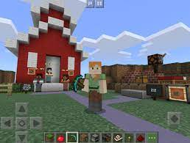
Examples
Free Rice – Vocabulary
Kahoot
Goosechase
Minecraft for Education
Quest to Learn
Flipgrid

Slide 24

Thank you!
Theresa E. Shattuck, Ph.D
Theresa Shattuck Educational Consulting, LLC
tshattuck53@verizon.net
https://www.prodigygame.com/main-en/blog/student-engagement-strategies#definition
https://www.gamify.com/gamification-blog/top-5-examples-of-gamified-education
https://www.edutopia.org/blog/golden-rules-for-engaging-students-nicolas-pino-james
https://www.edutopia.org/article/essay-assignments-actually-engage-high-school-writers

